Slide 1

Chapter 5:
Looping
Copyright © 2009 Pearson Education, Inc. Publishing as Pearson Addison-Wesley

Slide 2
5.1
The Increment and Decrement Operators

Slide 3
The Increment and Decrement Operators
++ is the increment operator.
It adds one to a variable.
  val++; is the same as val = val + 1;
++ can be used before (prefix) or after (postfix) a variable:
  ++val; val++;

Slide 4
The Increment and Decrement Operators
-- is the decrement operator.
It subtracts one from a variable.
  val--; is the same as val = val - 1;
-- can be also used before (prefix) or after (postfix) a variable:
  --val; val--;

Slide 5
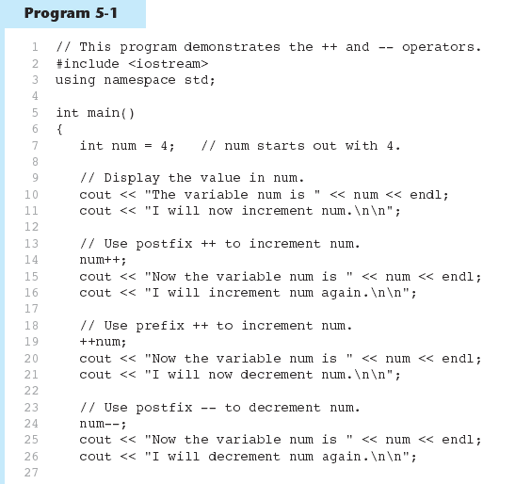
(Program Continues)

Slide 6
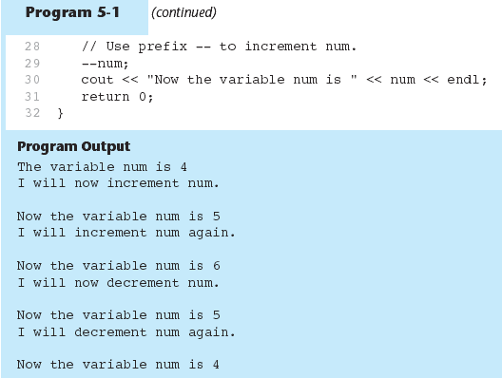

Slide 7
Prefix vs. Postfix
++ and -- operators can be used in complex statements and expressions
In prefix mode (++val, --val) the operator increments or decrements, then returns the value of the variable
In postfix mode (val++, val--) the operator returns the value of the variable, then increments or decrements

Slide 8
Prefix vs. Postfix - Examples
int num, val = 12;
cout << val++; // displays 12,
// val is now 13;
cout << ++val; // sets val to 14,
// then displays it
num = --val; // sets val to 13,
// stores 13 in num
num = val--; // stores 13 in num,
// sets val to 12

Slide 9
Notes on Increment, Decrement
Can be used in expressions:
  result = num1++ + --num2;
Must be applied to something that has a location in memory. Cannot have:
  result = (num1 + num2)++;
Can be used in relational expressions:
  if (++num > limit)
  pre- and post-operations will cause different comparisons

Slide 10
5.2
Introduction to Loops:
The while Loop

Slide 11
Introduction to Loops:
The while Loop
Loop: a control structure that causes a statement or statements to repeat
General format of the while loop:
  while (expression)
  statement;
statement; can also be a block of statements enclosed in { }

Slide 12
while Loop – How It Works
  while (expression)
  statement;
expression is evaluated
  if true, then statement is executed, and expression is evaluated again
  if false, then the the loop is finished and program statements following statement execute

Slide 13
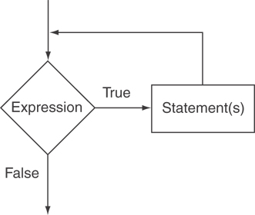
The Logic of a while Loop

Slide 14
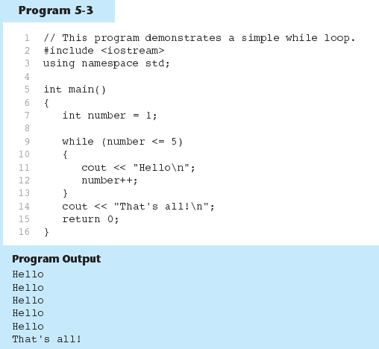

Slide 15
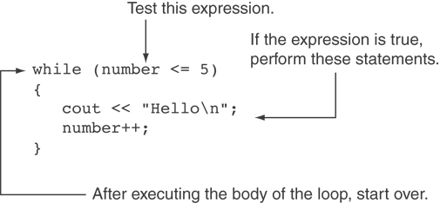
How the Loop in Lines 9 through 13 Works

Slide 16
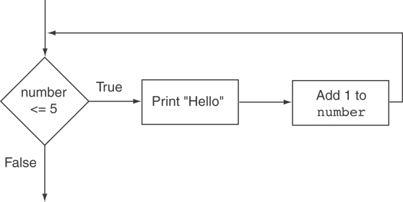
Flowchart of the Loop

Slide 17
while is a Pretest Loop
expression is evaluated before the loop executes. The following loop will never execute:
int number = 6;
while (number <= 5)
{
cout << "Hello\n";
number++;
}

Slide 18
Watch Out for Infinite Loops
The loop must contain code to make expression become false
Otherwise, the loop will have no way of stopping
Such a loop is called an infinite loop, because it will repeat an infinite number of times

Slide 19
An Infinite Loop
int number = 1;
while (number <= 5)
{
cout << "Hello\n";
}

Slide 20
5.3
Using the while Loop for Input Validation

Slide 21
Using the while Loop for Input Validation
Input validation is the process of inspecting data that is given to the program as input and determining whether it is valid.
The while loop can be used to create input routines that reject invalid data, and repeat until valid data is entered.

Slide 22
Using the while Loop for Input Validation
Here's the general approach, in pseudocode:
Read an item of input.
While the input is invalid
Display an error message.
Read the input again.
End While

Slide 23
Input Validation Example
cout << "Enter a number less than 10: ";
cin >> number;
while (number >= 10)
{
cout << "Invalid Entry!"
<< "Enter a number less than 10: ";
cin >> number;
}

Slide 24
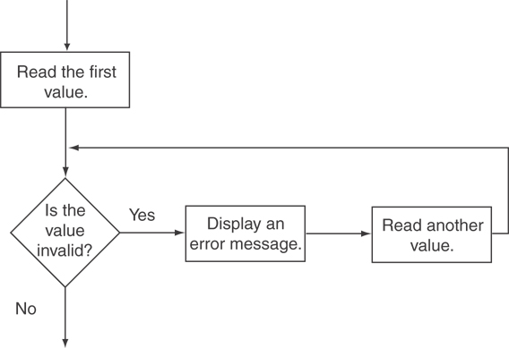
Flowchart

Slide 25
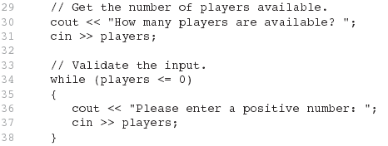
Input Validation Example from Program 5-5

Slide 26
5.4
Counters

Slide 27
Counters
Counter: a variable that is incremented or decremented each time a loop repeats
Can be used to control execution of the loop (also known as the loop control variable)
Must be initialized before entering loop

Slide 28

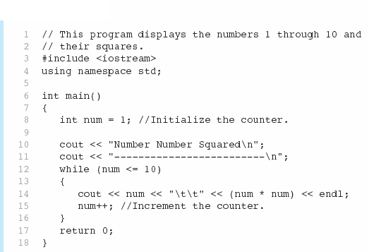

Slide 29
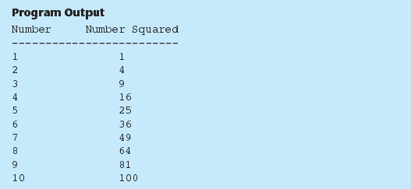

Slide 30
5.5
The do-while Loop

Slide 31
The do-while Loop
do-while: a posttest loop – execute the loop, then test the expression
General Format:
  do
  statement; // or block in { }
  while (expression);
Note that a semicolon is required after (expression)

Slide 32
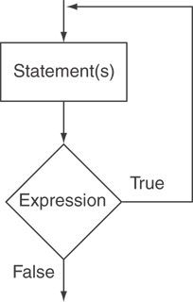
The Logic of a do-while Loop

Slide 33
do-while Example
int x = 1;
do
{
cout << x << endl;
} while(x < 0);
Although the test expression is false, this loop will execute one time because do-while is a posttest loop.

Slide 34
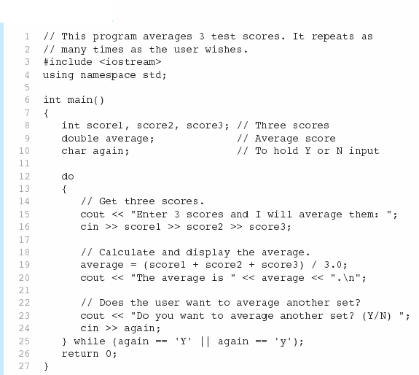


Slide 35
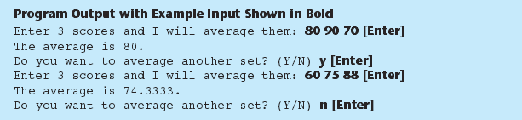

Slide 36
do-while Loop Notes
Loop always executes at least once
Execution continues as long as expression is true, stops repetition when expression becomes false
Useful in menu-driven programs to bring user back to menu to make another choice (see Program 5-8 in the book)

Slide 37
5.6
The for Loop

Slide 38
The for Loop
Useful for counter-controlled loop
General Format:
  for(initialization; test; update)
  statement; // or block in { }
No semicolon after 3rd expression or after the )

Slide 39
for Loop - Mechanics
for(initialization; test; update)
  statement; // or block in { }
Perform initialization
Evaluate test expression
  If true, execute statement
  If false, terminate loop execution
Execute update, then re-evaluate test expression

Slide 40
for Loop - Example
int count;
for (count = 1; count <= 5; count++)
  cout << "Hello" << endl;

Slide 41
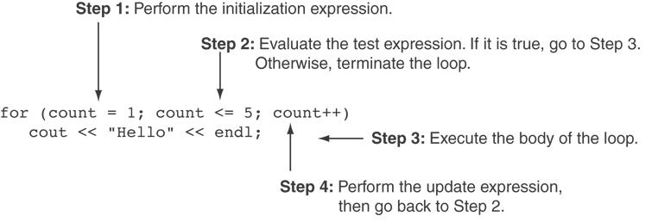
A Closer Look at the Previous Example

Slide 42
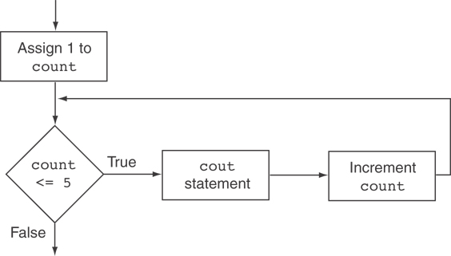
Flowchart for the Previous Example

Slide 43
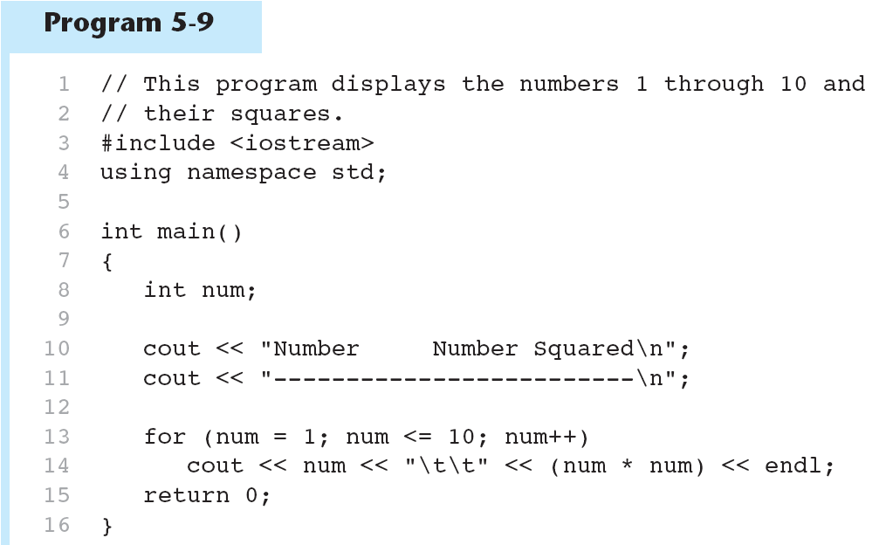

Slide 44


Slide 45
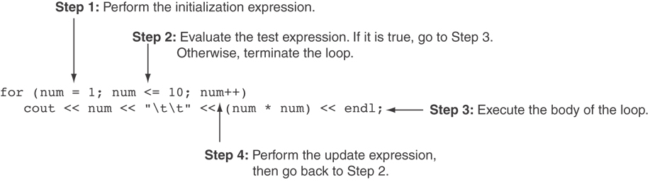
A Closer Look at Lines 13 through 14 in Program 5-9

Slide 46
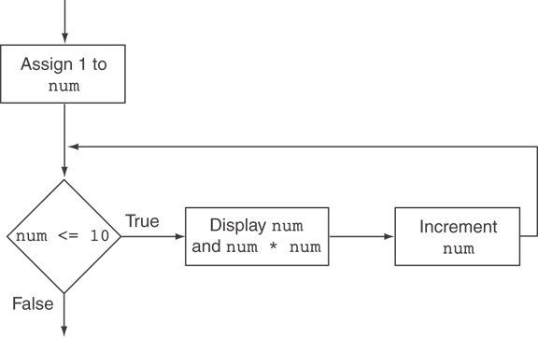
Flowchart for Lines 13 through 14 in Program 5-9

Slide 47
When to Use the for Loop
In any situation that clearly requires
  an initialization
  a false condition to stop the loop
  an update to occur at the end of each iteration

Slide 48
The for Loop is a Pretest Loop
The for loop tests its test expression before each iteration, so it is a pretest loop.
The following loop will never iterate:
for (count = 11; count <= 10; count++)
cout << "Hello" << endl;

Slide 49
for Loop - Modifications
You can have multiple statements in the initialization expression. Separate the statements with a comma:
int x, y;
for (x=1, y=1; x <= 5; x++)
{
cout << x << " plus " << y
<< " equals " << (x+y)
<< endl;
}
Initialization Expression

Slide 50
for Loop - Modifications
You can also have multiple statements in the test expression. Separate the statements with a comma:
int x, y;
for (x=1, y=1; x <= 5; x++, y++)
{
cout << x << " plus " << y
<< " equals " << (x+y)
<< endl;
}
Test Expression

Slide 51
for Loop - Modifications
You can omit the initialization expression if it has already been done:
int sum = 0, num = 1;
for (; num <= 10; num++)
sum += num;

Slide 52
for Loop - Modifications
You can declare variables in the initialization expression:
  int sum = 0;
  for (int num = 0; num <= 10; num++)
  sum += num;
  The scope of the variable num is the for loop.

Slide 53
5.7
Keeping a Running Total

Slide 54
Keeping a Running Total
running total: accumulated sum of numbers from each repetition of loop
accumulator: variable that holds running total
  int sum=0, num=1; // sum is the
  while (num <= 10) // accumulator
  { sum += num;
  num++;
  }
  cout << "Sum of numbers 1 – 10 is"
  << sum << endl;

Slide 55

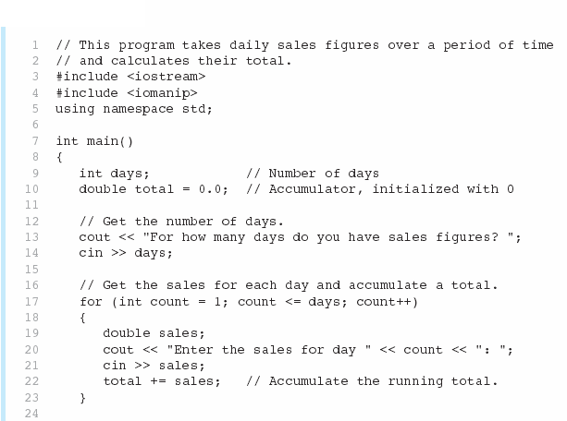
(Program Continues)

Slide 56

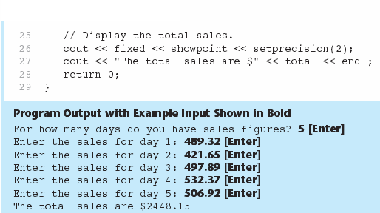

Slide 57
5.8
Sentinels

Slide 58
Sentinels
sentinel: value in a list of values that indicates end of data
Special value that cannot be confused with a valid value, e.g., -999 for a test score
Used to terminate input when user may not know how many values will be entered

Slide 59
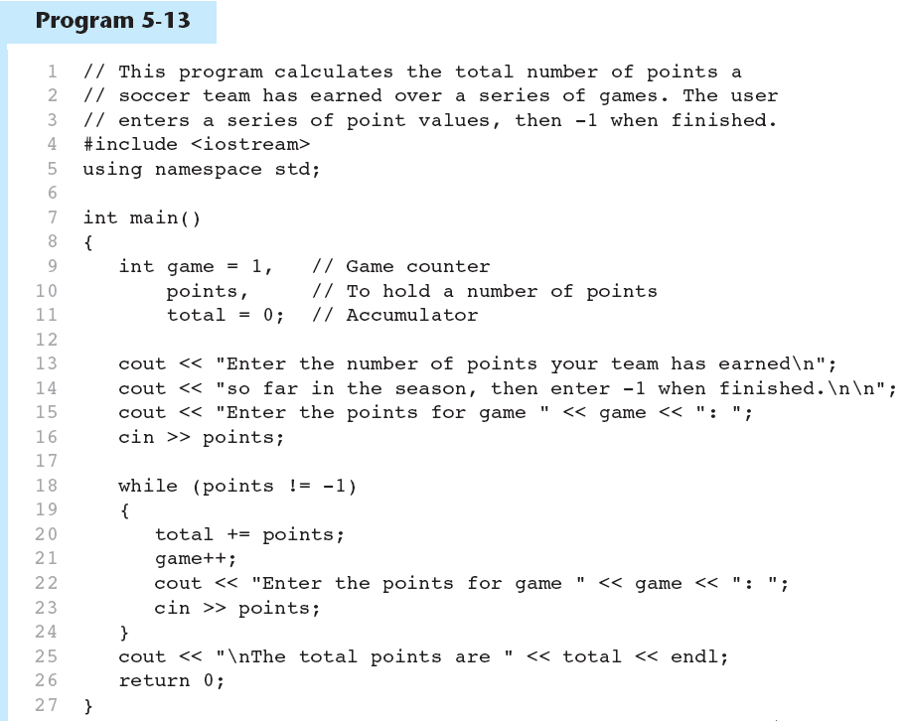
(Program Continues)

Slide 60
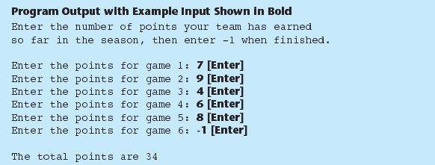

Slide 61
5.9
Using a Loop to Read Data from a File

Slide 62
Using a Loop to Read Data from a File
The stream extraction operator >> returns true when a value was successfully read, false otherwise
Can be tested in a while loop to continue execution as long as values are read from the file:
  while (inputFile >> number) ...

Slide 63
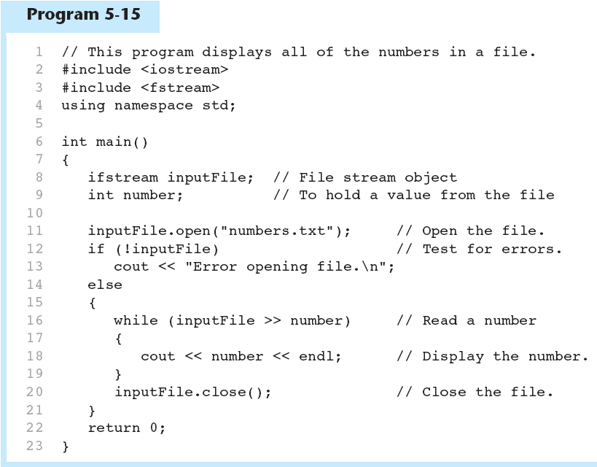

Slide 64
5.10
Deciding Which Loop
to Use

Slide 65
Deciding Which Loop to Use
while: pretest loop; loop body may not be executed at all
do-while: posttest loop; loop body will always be executed at least once
for: pretest loop with initialization and update expression; useful with counters, or if precise number of repetitions is needed

Slide 66
5.11
Nested Loops

Slide 67
Nested Loops
A nested loop is a loop inside the body of another loop
Inner (inside), outer (outside) loops:
  for (row=1; row<=3; row++) //outer
  for (col=1; col<=3; col++)//inner
  cout << row * col << endl;

Slide 68
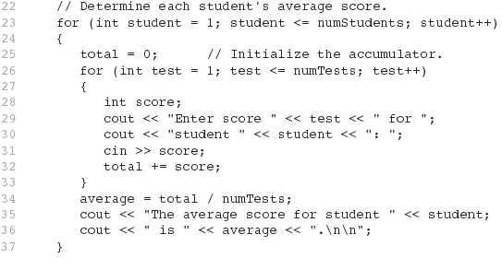
Lines from Program 5-16

Slide 69
Nested Loops - Notes
Inner loop goes through all repetitions for each repetition of outer loop
Inner loop repetitions complete sooner than outer loop
Total number of repetitions for inner loop is product of number of repetitions of the two loops.

Slide 70
5.12
Breaking Out of a Loop

Slide 71
Breaking Out of a Loop
Can use break to terminate execution of a loop
Use sparingly if at all – makes code harder to understand and debug
When used in an inner loop, terminates that loop only and goes back to outer loop

Slide 72
5.13
The continue Statement

Slide 73
The continue Statement
Can use continue to go to end of loop and prepare for next repetition
  while, do-while loops: go to test, repeat loop if test passes
  for loop: perform update step, then test, then repeat loop if test passes
Use sparingly – like break, can make program logic hard to follow

